Slide 1


Yu-Han Shiny App Presentation

Slide 2
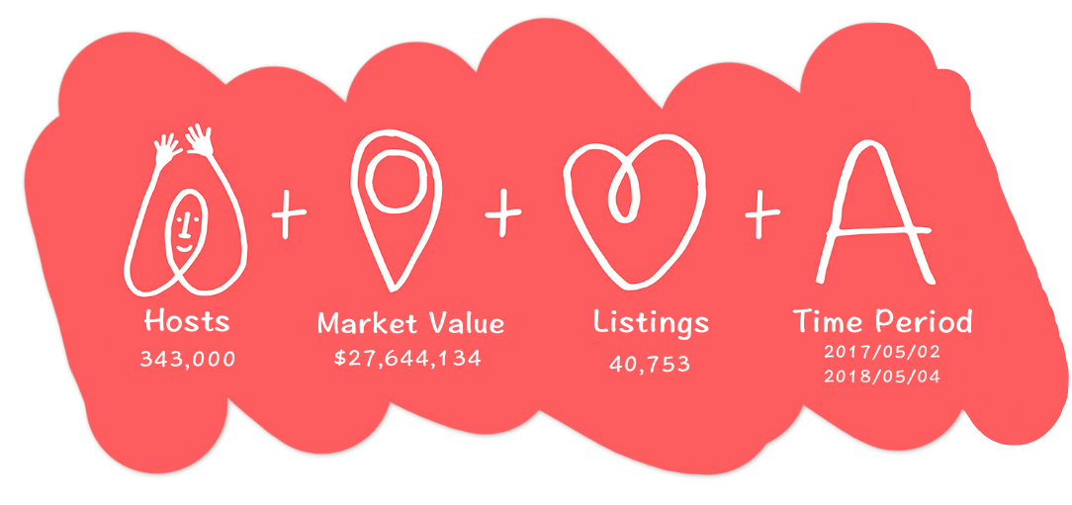
Overview

Slide 3
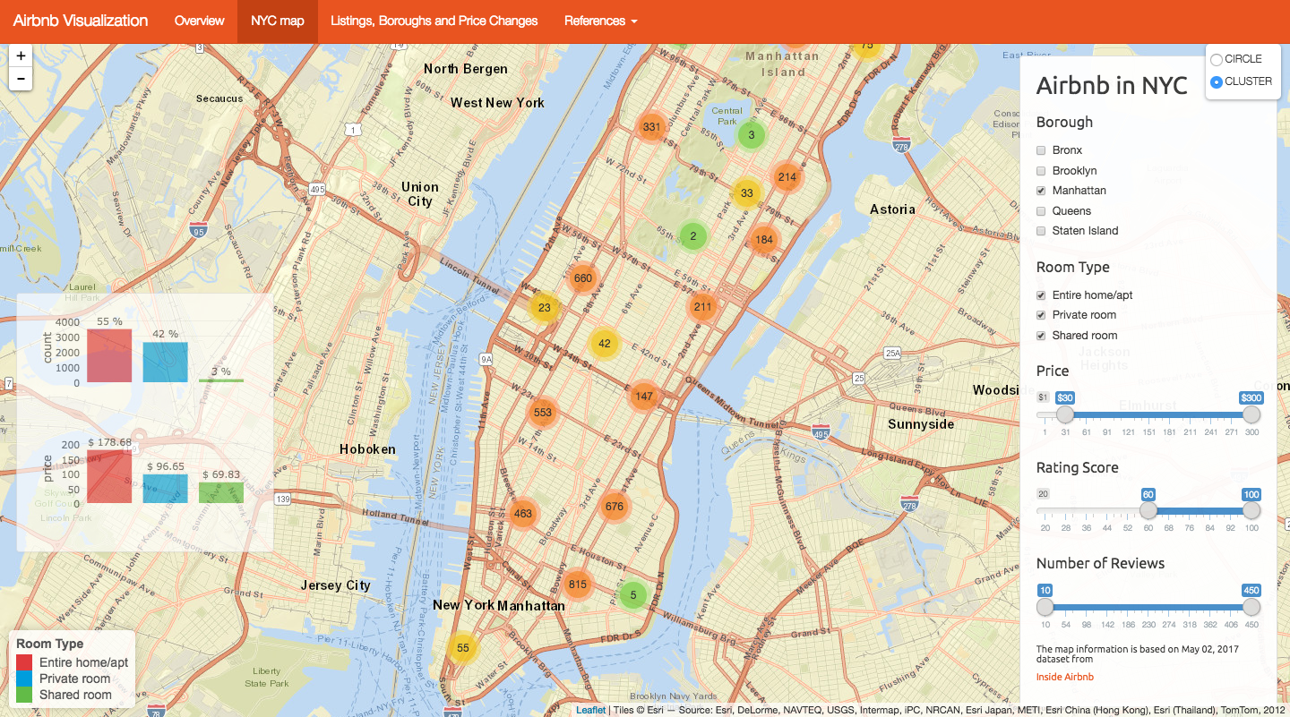
NYC Map

Slide 4
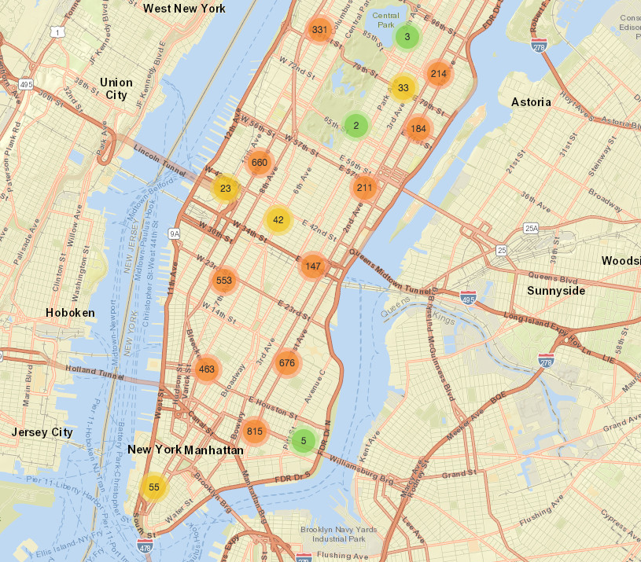
NYC Map
Lower Manhattan
East Village
Nolita

Slide 5
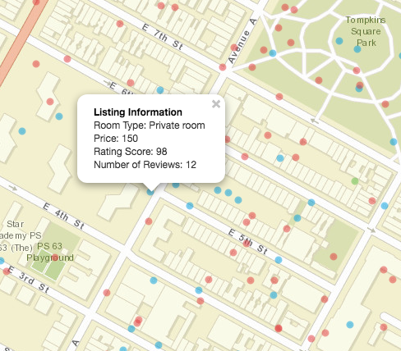
NYC Map
Detailed Information

Slide 6
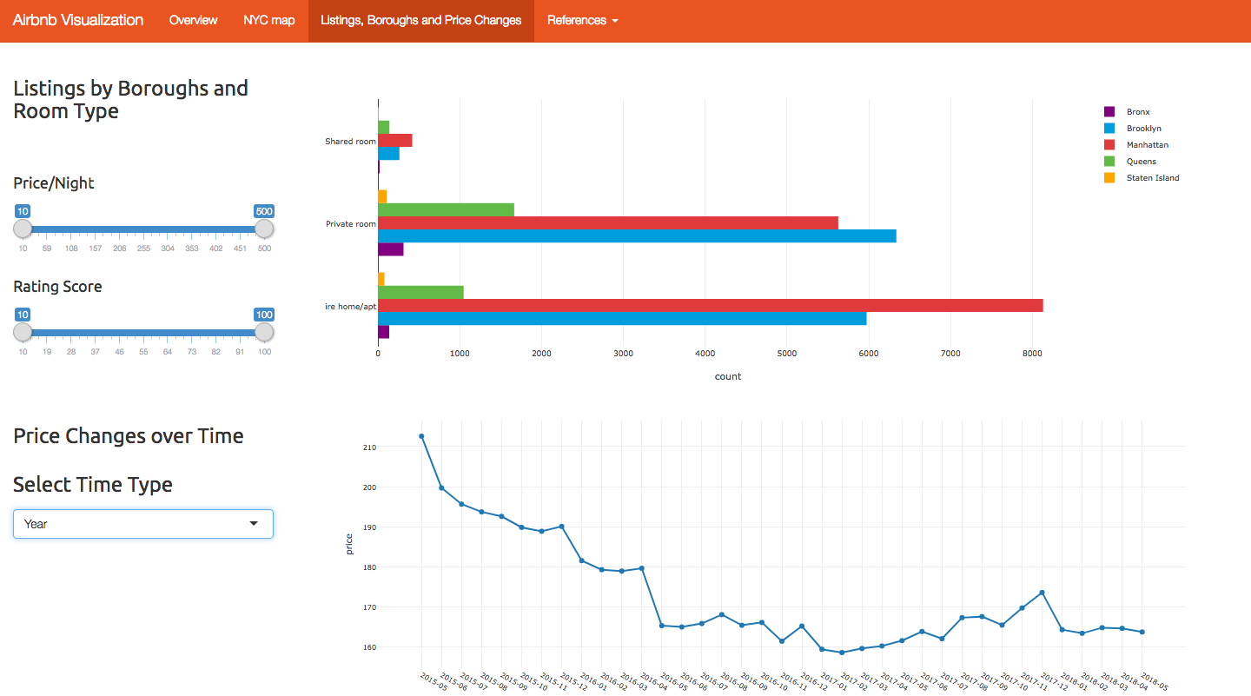
Listing, Boroughs & Price Changes

Slide 7
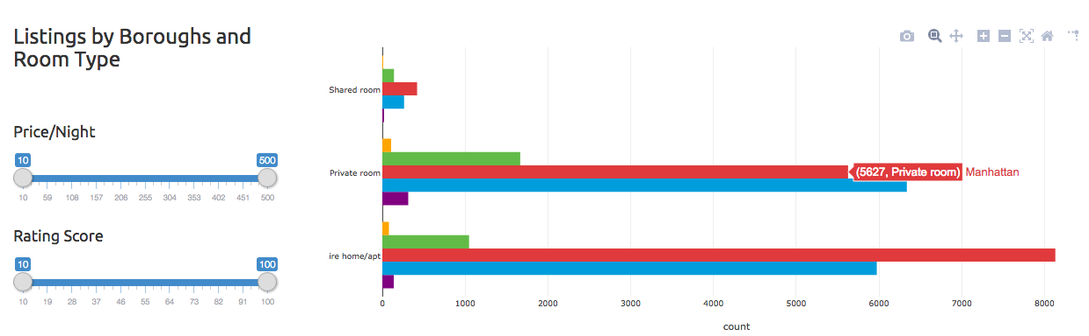
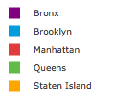
Listings
How many listings available for given selection

Slide 8
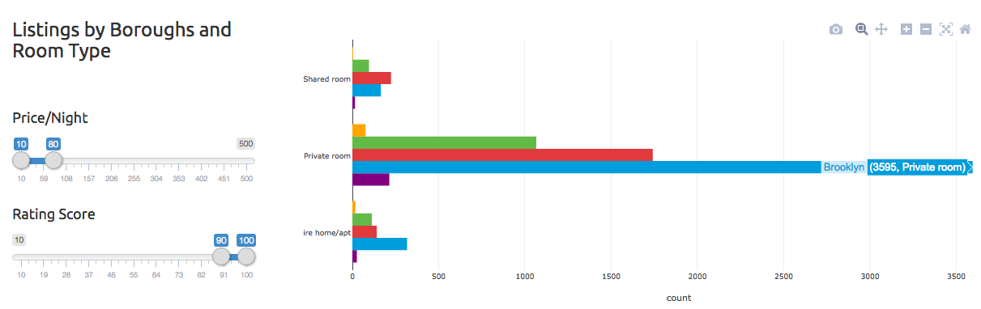
Listings
Price-Performance Ratio
limited budget, great experience

Slide 9
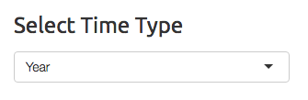
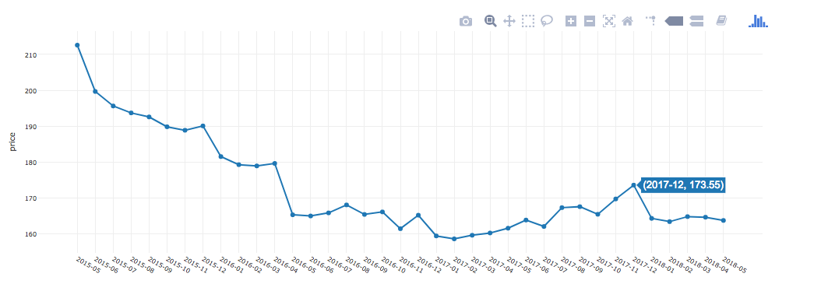
Price Changes over Year
2017 Dec
Price goes down, 2016 May

Slide 10
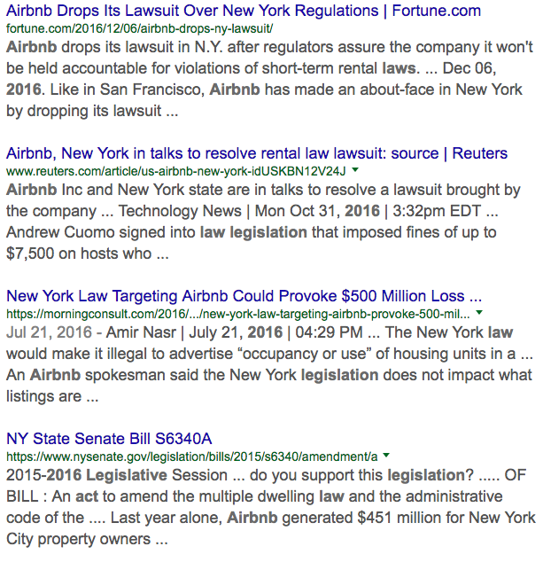

Possible Reasons
Multiple Dwelling Law
Competition
Room Type

Slide 11
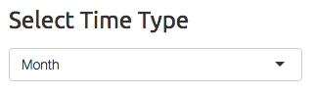
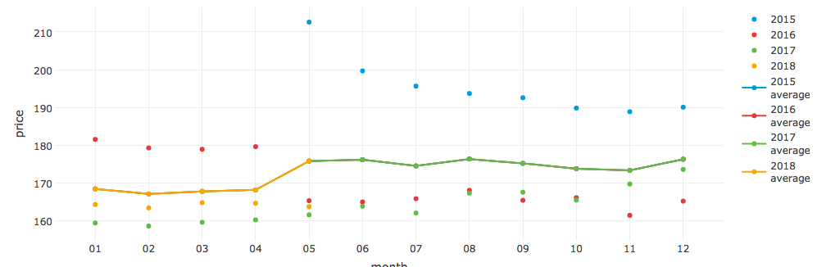
Price Changes over Month
average
May, June, August, December
July

Slide 12

Showtime!

